Slide 1
Effects of the Legalization of Marijuana in the State of Colorado
Fred Castrow
Zach Steele
Devon Firestone
Mustafa Ancin

Slide 2
Colorado - Recreational marijuana was legalized in 2012
Areas of focus
Rates of marijuana use before and after legalization.
Compared to Texas and the United States
Rates of other substance use before and after legalization.
Compared to Texas and the United States
Rates of mental health issues before and after legalization.
Rates of crime/incarceration before and after legalization.
Motivation
Marijuana legalization is becoming more prevalent, and we wanted to see the effects for a case study i.e. Colorado.

Slide 3



Data Sources and Cleanup
Data came in CSV files that were available from these sources and concatenated.
Other datasets were too big or unavailable such as snack food sales.
Other correlations considered were hospital visits, THC in new borns, driving while influenced by Marijuana, School test scores.

Slide 4
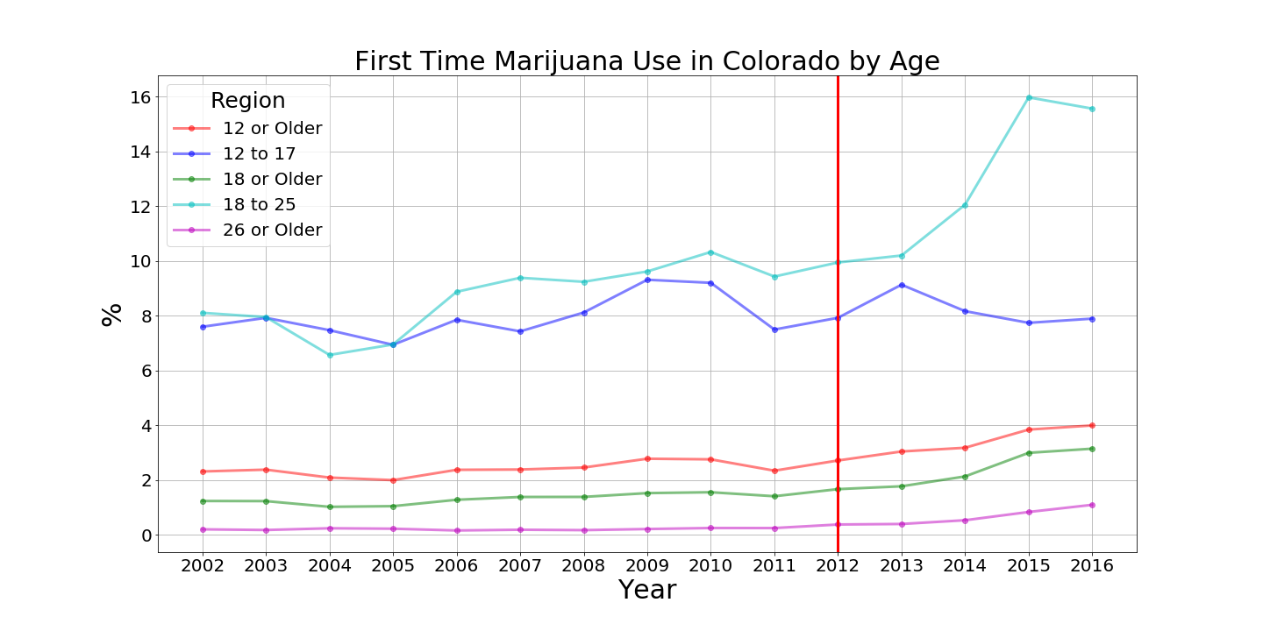

Slide 5
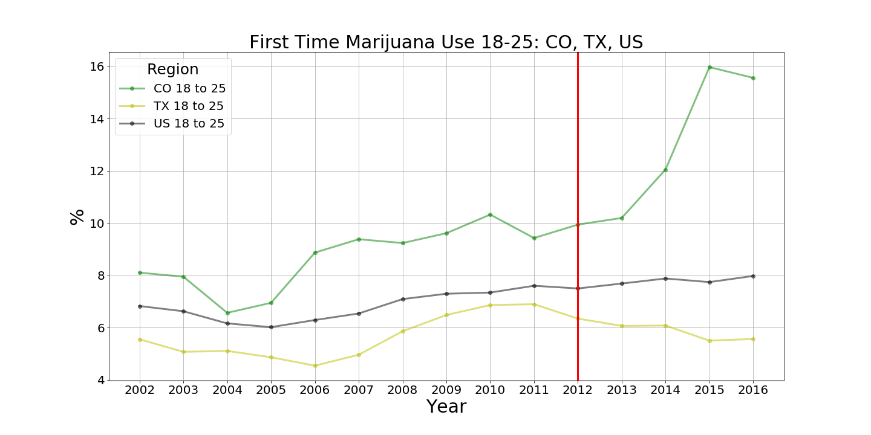

Slide 6
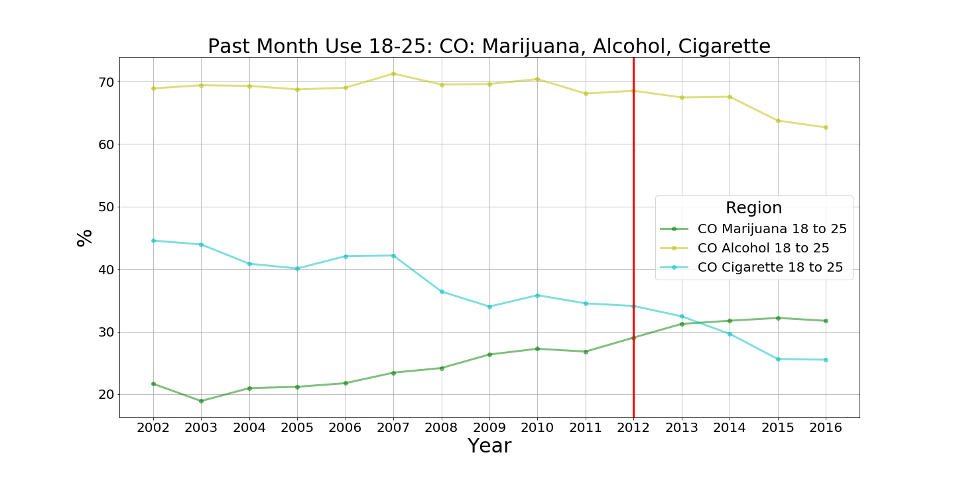

Slide 7
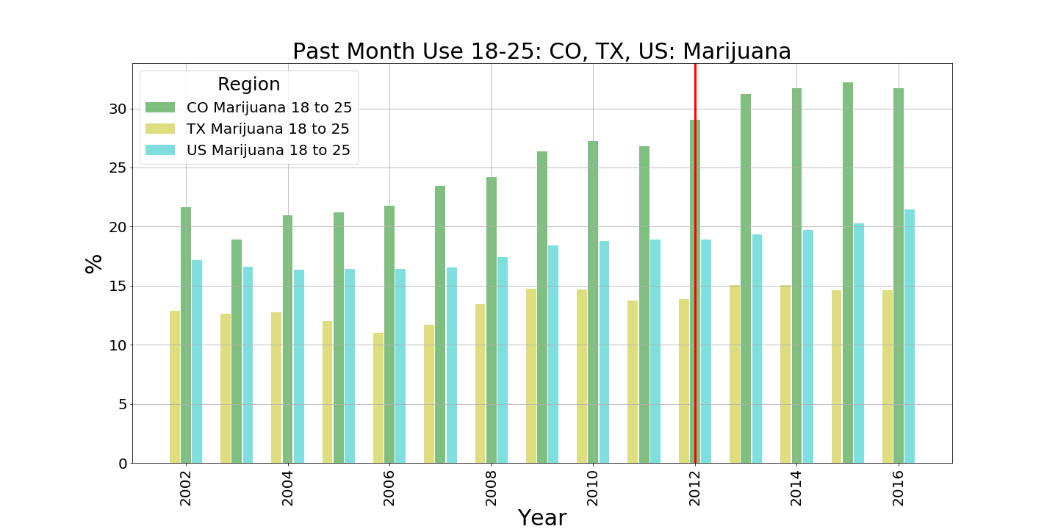

Slide 8
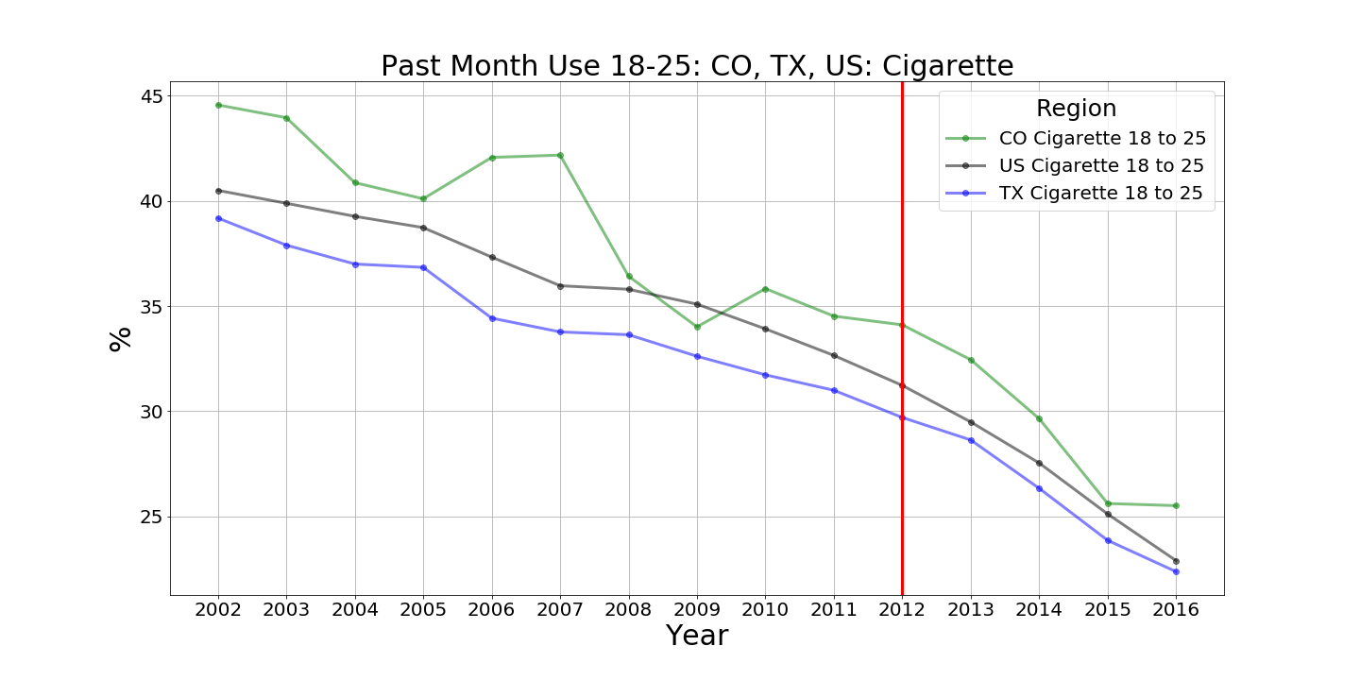

Slide 9
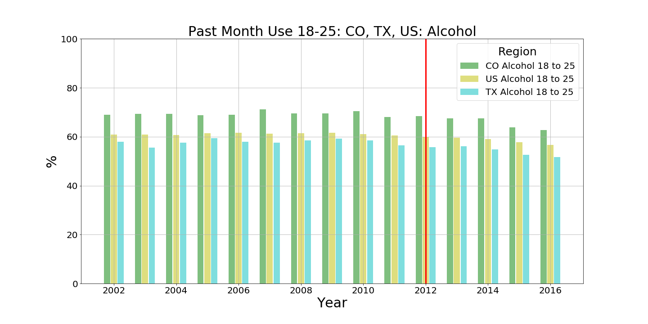

Slide 10
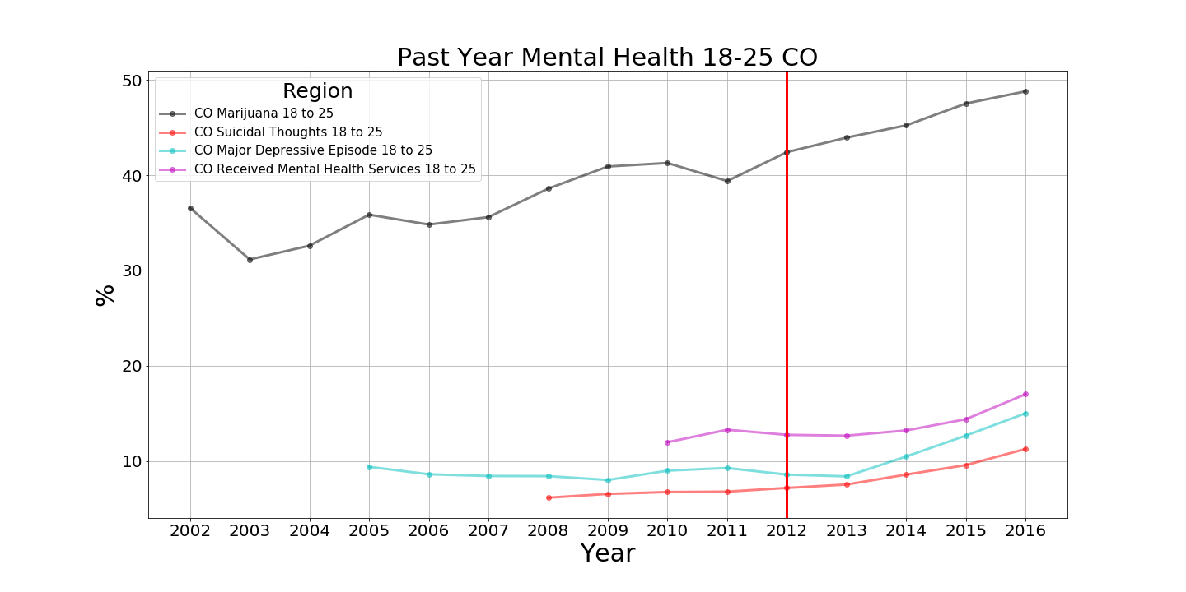

Slide 11
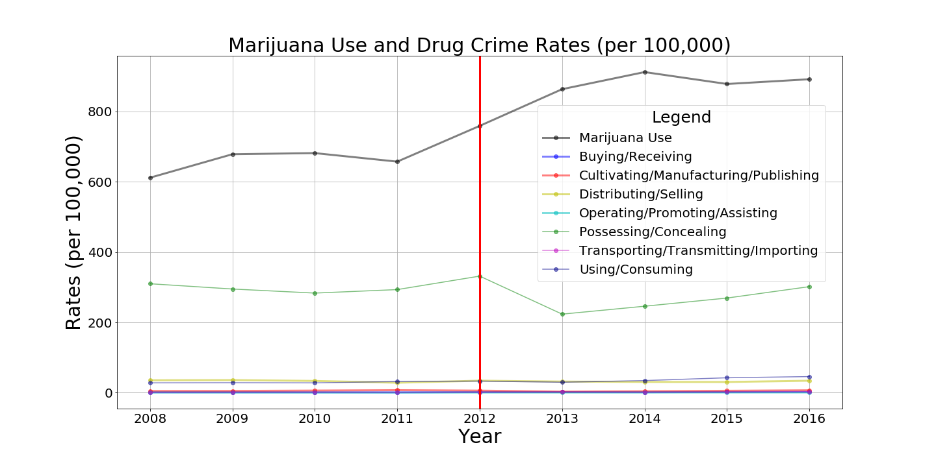

Slide 12
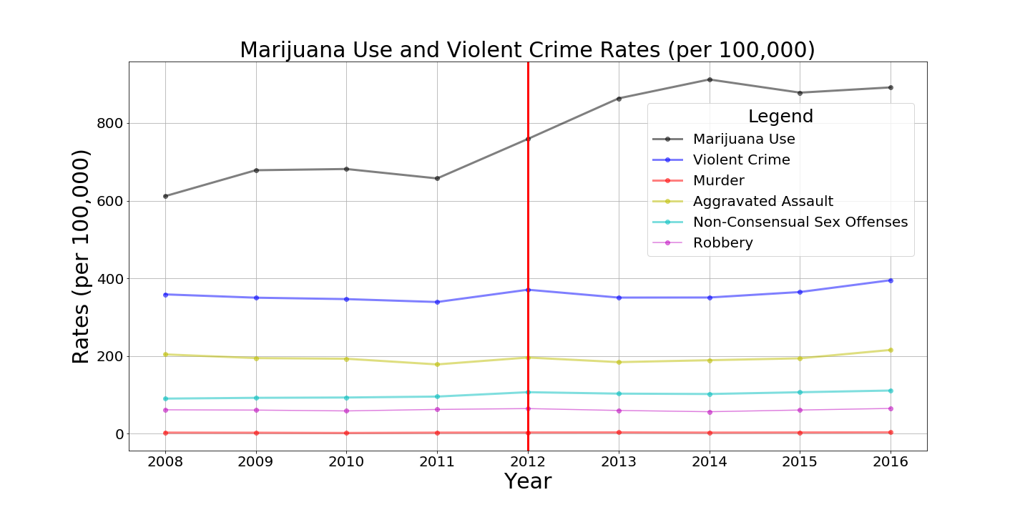

Slide 13
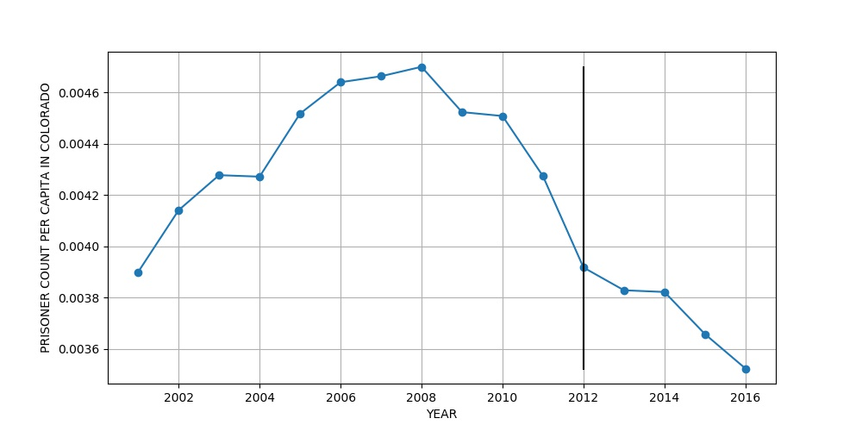
Prisoner Count per Capita in CO After the Legalization of Marijuana

Slide 14
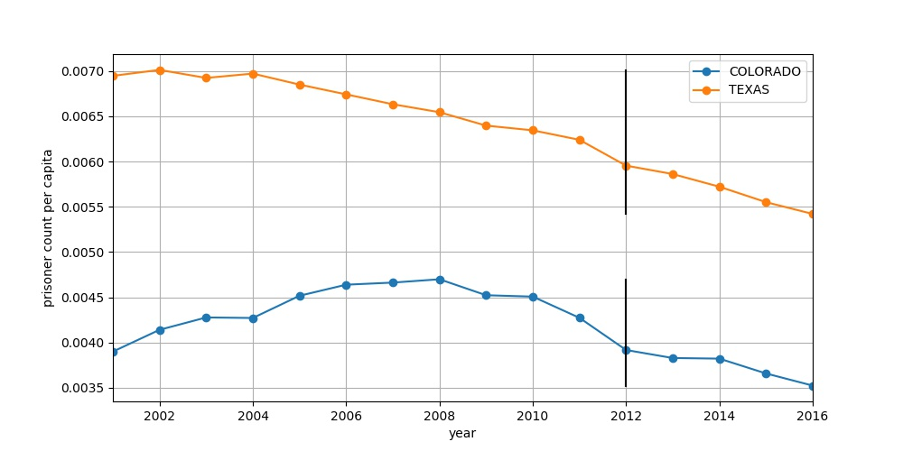
Comparison of Prisoner Per Capita Between TX and CO

Slide 15

Conclusions:
There is a significant effect for 18-25 years-olds for trying Marijuana for the first time after it becomes legal.
Slight increase in past month use of Marijuana for 18-25 years olds in Colorado.
No affect on other substance use or mental health issues after legalization.
No correlation on the rate drug and violent crimes after legalization.
Slight decrease in drug possession crimes after legalization.
No correlation between incarceration rates and marijuana use.

